Slide 1

Module I:
SDLC Model - Waterfall & Incremental Process model
Software Engineering

Slide 2

Module I: SOFTWARE PROCESS MODEL
SDLC- SDLC Models-Overview of Agile Development Models: Scrum - Scrum Roles - Scrum Meetings - Scrum Artifacts - Extreme Programming, Feature Driven Development, Kanban and Lean Software Development - DevOps and benefits.Case Study: SDLC followed in MNCs ( Infosys, CTS, Google, etc..)

Slide 3
Course Outcomes:
CO1 : Compare the various software process models and select the suitable model. (K3 Apply)
CO2 : Analyze the complexity of the project and develop the project plan. (K4 Analyze)
CO3 : Construct the UML diagrams for a project using software design methodology.(K3 Apply)
CO4 : Analyze and apply the appropriate software testing strategy in the chosen project.(K4 Analyze)
CO5 : Demonstrate the knowledge on contemporary tools in software engineering.(K3 Apply)

Slide 4

Agenda:
Process Model
Perspective Process Model
Different Perspective Process Model
The Waterfall Model
Incremental Process model
Reuse-oriented software engineering
Iterative Model

Slide 5
Process Model
An abstract representation of process.
Software process model is also known as Software Development Life Cycle(SDLC).

Slide 6
Perspective Process Model
Perspective process model follow some rules for correct usage.
It defines a distinct set of activities, actions, tasks, milestones, and work products that are required to engineer high-quality software
The activities may be linear, incremental, or evolutionary.
Each process model represents a process from a particular perspective, and thus provides only partial information about that process.

Slide 7
Different Perspective Process Model
There are three types of prescriptive process models. They are: 1. The Waterfall Model 2. Incremental Process model 3. Reuse-oriented software engineering

Slide 8
Observe and share your view

Slide 9
1. The Waterfall Model
The waterfall model is also called as 'Linear sequential model' or 'Classic life cycle model'.
In this model, each phase is fully completed before the beginning of the next phase.
This model is used for the small projects.
In this model, feedback is taken after each phase to ensure that the project is on the right path.
Testing part starts only after the development is complete.

Slide 10
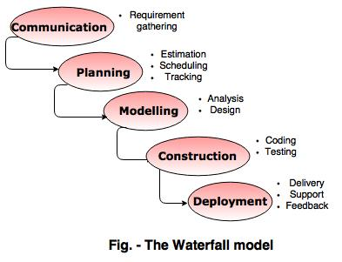
The Waterfall Model

Slide 11
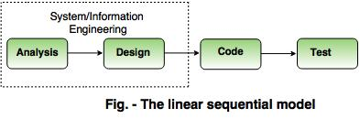
Alternate Design:
An alternative design for 'linear sequential model' is as follows:

Slide 12
Advantages
The waterfall model is simple and easy to understand, implement, and use.
All the requirements are known at the beginning of the project, hence it is easy to manage.
It avoids overlapping of phases because each phase is completed at once.
This model works for small projects because the requirements are understood very well.
This model is preferred for those projects where the quality is more important as compared to the cost of the project.

Slide 13
Disadvantages
This model is not good for complex and object oriented projects.
It is a poor model for long projects.
The problems with this model are uncovered, until the software testing.
The amount of risk is high.

Slide 14
When to use the waterfall model?
For small projects.
When requirements are clear.
When customer involvement is less.
For low budget projects.

Slide 15
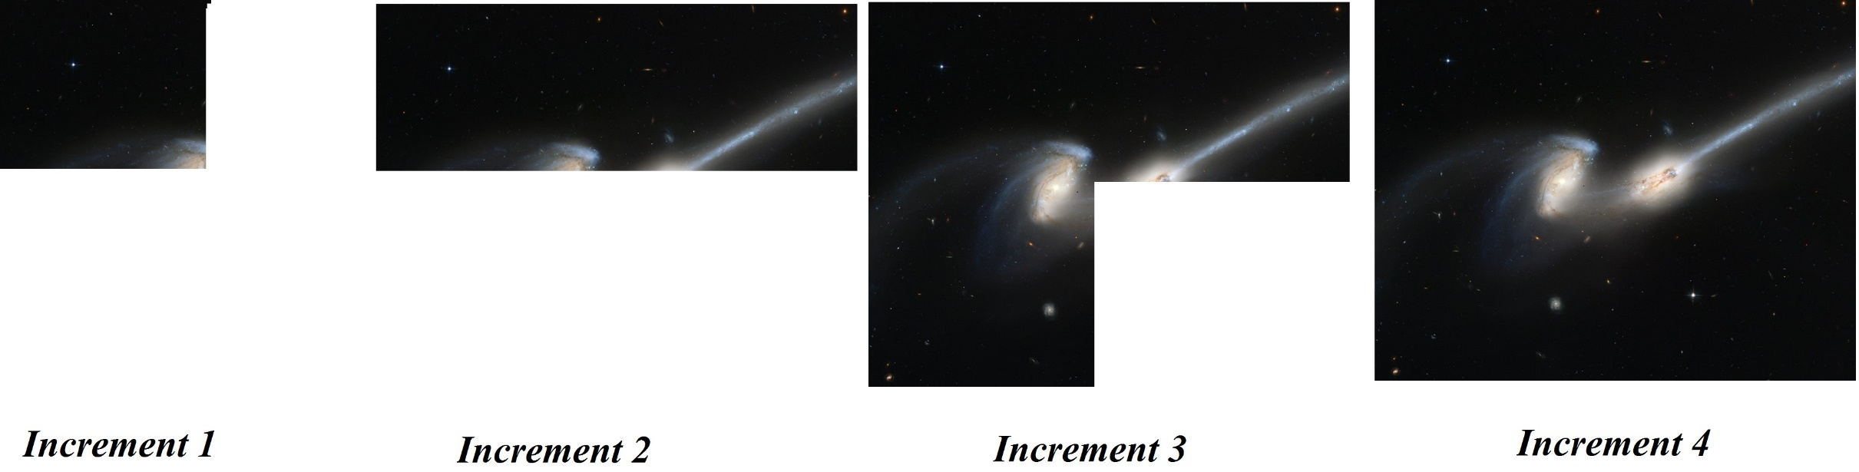
Observe and share your view
Img Source: https://cdn.spacetelescope.org/archives/images/screen/heic0206b.jpg

Slide 16
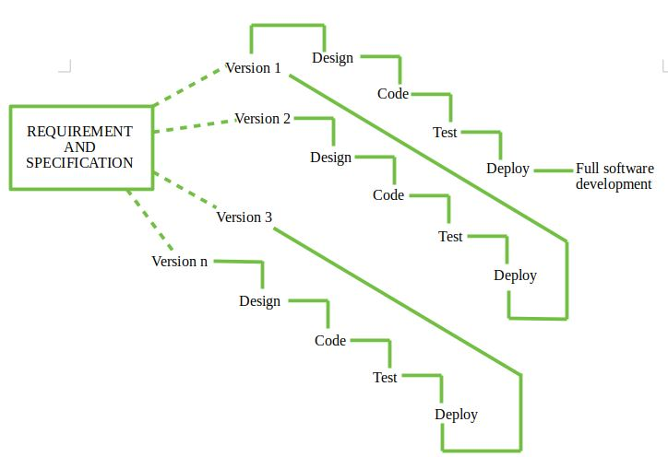
2. Incremental Process model
This model combines the elements of waterfall model and they are applied in an iterative fashion.
The first increment in this model is generally a core product.
Each increment builds the product and submits it to the customer for any suggested modifications.
The next increment implements on the customer's suggestions and add additional requirements in the previous increment.
This process is repeated until the product is finished.
Example: word-processing software,

Slide 17
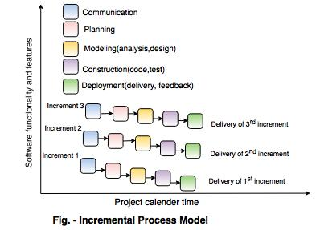
Incremental Process model

Slide 18
Advantages
This model is flexible because the cost of development is low and initial product delivery is faster.
Easy to test and debug during the smaller iteration.
The working software generates quickly and early during the software life cycle.
The customers can respond (feedback) to its functionalities after every increment.

Slide 19
Disadvantages
The cost of the final product may cross the cost estimated initially.
This model requires a very clear and complete planning.
The planning of design is required before the whole system is broken into small increments.
The demands of customer for the additional functionalities after every increment causes problem during the system architecture.

Slide 20
When to use the incremental model?
When major requirements are understood but some requirements can evolve within the passage of time.
When product launch in the market is getting late.
When a customer has no problem with the budget but he demands more and more quality in software.

Slide 21

Observe and share your view

Slide 22
3. Reuse-Oriented Model:
Reuse Oriented Model (ROM), also known as reuse-oriented development (ROD).
Developing the software by using the existing software components.
Some of the components that can be reuse are as follows:
Source code
Design and interfaces
User manuals
Software Documentation
Software requirement specifications and many more

Slide 23
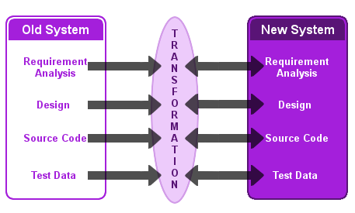
Observe and share your view

Slide 24
Fundamental steps in ROM:
The reuse model has 4 fundamental steps which are followed
Identify components of old system that are most suitable for reuse.
Understand all system components.
Modify old system components to achieve new requirements.
Integrate all of modified parts into new system.

Slide 25
Advantages:
It can reduce total cost of software development.
The risk factor is very low.
It can save lots of time and effort.
It is very efficient in nature.

Slide 26
Disadvantages:
Reuse-oriented model is not always worked as a practice in its true form.
Compromises in requirements may lead to a system that does not fulfill requirement of user.
Sometimes using old system component, that is not compatible with new version of component, this may lead to an impact on system evolution

Slide 27
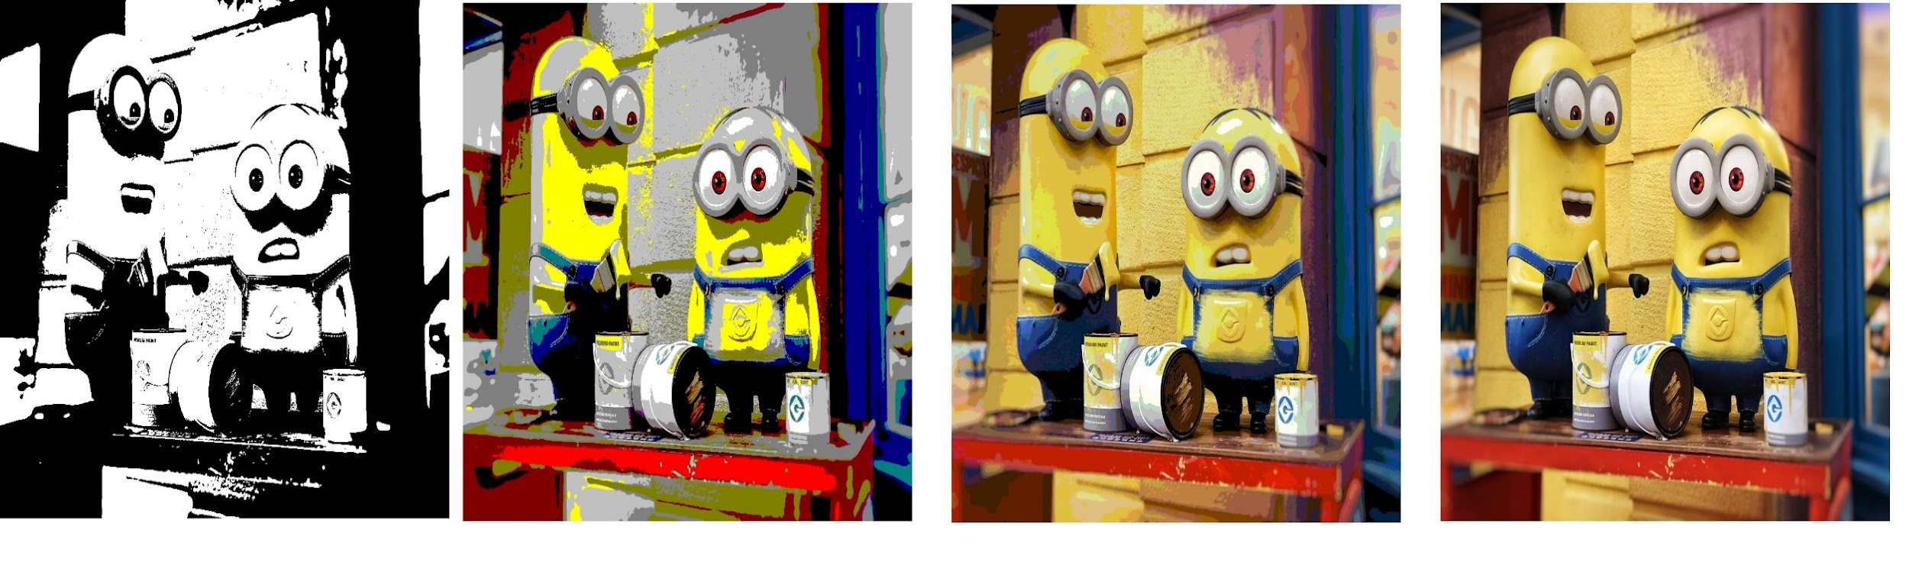
Observe and share your view

Slide 28
Iterative Model:
In iterative model, developer can start with some of the Software Requirement Specifications (SRS) and develop the first version of the software.
After the first version if there is a need to change the software, then a new version of the software is created with a new iteration.
Every release of the Iterative Model finishes in an exact and fixed period that is called iteration.
The Iterative Model allows the accessing earlier phases, in which the variations made respectively.
The final output of the project renewed at the end of the Software Development Life Cycle (SDLC) process.

Slide 29
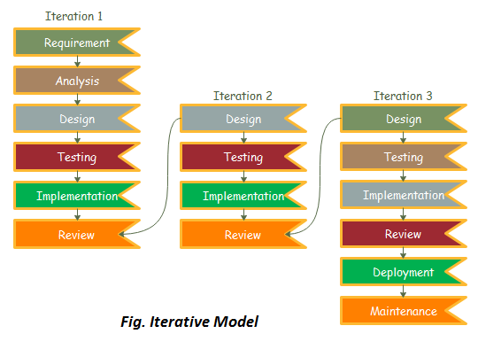
Iterative Model:

Slide 30
Iterative Model: Various Phases
Various phases of Iterative model are as follows:
1. Requirement gathering & analysis
2. Design
3. Implementation
4. Testing
5. Deployment
6. Review
7. Maintenance

Slide 31
Advantages:
Testing and debugging during smaller iteration is easy.
Parallel development can be done.
Easily acceptable to ever-changing needs of the project.
Risks are identified and resolved during iteration.
Limited time spent on documentation and extra time on designing.

Slide 32
Disadvantages:
It is not suitable for smaller projects.
More Resources may be required.
Design can be changed again and again because of imperfect requirements.
Requirement changes can cause over budget.
Project completion date not confirmed because of changing requirements.

Slide 33
When to use the Iterative Model?
When requirements are defined clearly and easy to understand.
When the software application is large.
When there is a requirement of changes in future.

Slide 34
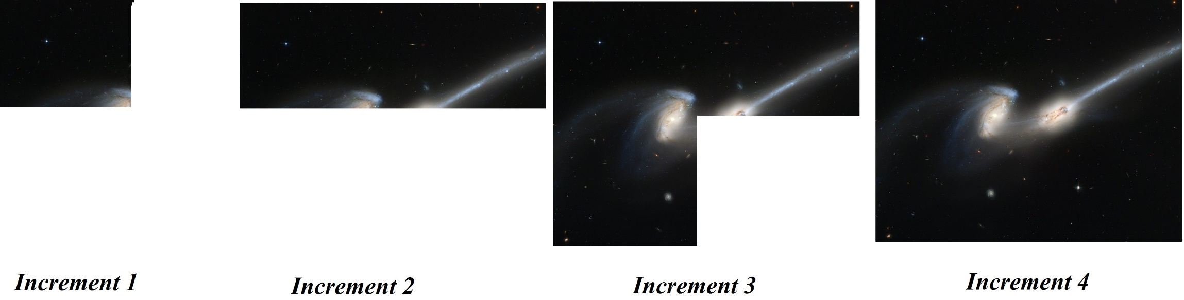
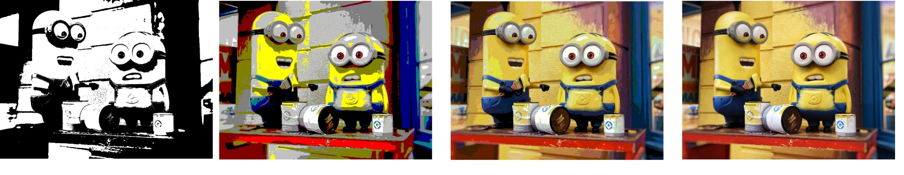
Difference between Incremental and Iterative model

Slide 35


Slide 36


